Slide 1
The University of Texas at Arlington The Department of Computer Science and Engineering CSE-6363-003-MACHINE LEARNING
Gender and Age detection with Emotion recognition
Geethika Lingamaneni
Roshini Tadi
Snigdha Kethireddy

Slide 2
INTRODUCTION
Human facial image processing and emotion detection has been an active and interesting research topic over years. Since human faces provide a lot of information, many topics have drawn lots of attentions.
Predicting the gender and age along with emotions from the images in unconstrainted conditions is one of the challenging task in many real world applications.
Gender-age and emotion detection play a key role in the consumer applications.
Humans are capable of producing thousands of facial actions during communication that vary in complexity, intensity, and meaning.
The automatic recognition of emotions has been an active research topic from early eras.

Slide 3
Emotion recognition helps to identify human emotion. People vary widely in their accuracy at recognizing the emotions of others.
In deep learning, CNN(Convolutional neural network or ConvNet) is a class of deep neural networks, most ordinarily applied to analyzing visual imagery. CNNs use little pre-processing when compared to other image classification algorithms.
TensorFlow can train and run deep neural networks for handwritten digit classification, sequence-to-sequence models for artificial intelligence, image recognition etc.
Keras is an open-source library. It provides a Python interface for artificial neural networks.

Slide 4
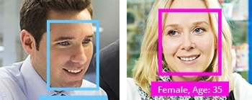
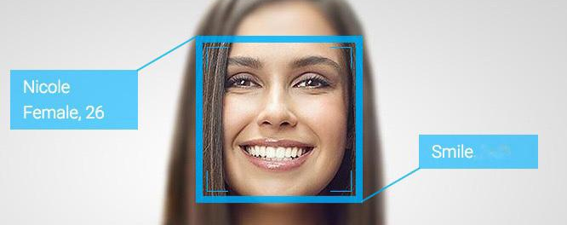
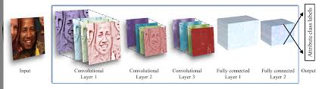
PROPOSED METHOD
Our proposed idea is to detect the gender and age of the people along with their emotions for the images or the video or through the webcam.
We will be using deep learning mechanisms to classify the dataset based on gender, age and emotion.

Slide 5
System Architecture
Camera/ Images/ Videos
Input Data Frames
Data Preprocessing
Classification and detection
Gender
Age
Emotion
Feature Extraction

Slide 6
Developed Approach
For our proposed model detect the faces from the considered dataset. Here we have used UTK Data set in order to train our model and tested using the coco images and open cv.
So we basically extracted the information of the image from the label. Next, we have split the dataset into 75% training and 25% testing in order to generate our model.
In the process of model-generation we used CNN. Finally we applied the activation functions like the relu and sigmoid and constructed the model. With the help of the saved model by above process, we generated Epoch for every batch of the data and got the accuracy, mean-loss.

Slide 7
For emotion detection, we have used CNN to train our model
We have taken coco dataset to train and test the model, 70% for training , 30% for testing
We have used 2D convolution and used resnet layers to filter our test set
We have divided the test set into batch size of 128 and 30 epochs and got accuracy, mean-loss for every batch.
At last we add the gender-age and emotion labels to the resulting image and displayed it.

Slide 8
Papers Referred
A study on face recognition techniques with age and gender classification
S. Kumar, S. Singh and J. Kumar, "A study on face recognition techniques with age and gender classification," 2017 International Conference on Computing, Communication and Automation (ICCCA), Greater Noida, 2017, pp. 1001-1006, doi: 10.1109/CCAA.2017.8229960.
Age and Gender Prediction Using Convolutional Neural Networks
Safak, Emre & Barişçi, Necaattin. (2018). Age and Gender Prediction Using Convolutional Neural Networks. 1-7. 10.1109/ISMSIT.2018.8567066.
Gender and Age Estimation Based on Facial Images
Khaung Tin, Dr.Hlaing Htake. (2011). Gender and Age Estimation Based on Facial Images. International Journal : ACTA TECJNICA NAPOCENSIS Electronics and Telecommunications.

Slide 9
Continuation
Overview on emotion recognition system
A. A. Varghese, J. P. Cherian and J. J. Kizhakkethottam, "Overview on emotion recognition system," 2015 International Conference on Soft-Computing and Networks Security (ICSNS), Coimbatore, 2015, pp. 1-5, doi: 10.1109/ICSNS.2015.7292443.
Human Emotion Recognition System
Singh, Dilbag. (2012). Human Emotion Recognition System. International Journal of Image, Graphics and Signal Processing. 4. 10.5815/ijigsp.2012.08.07.

Slide 10
Main References used:
https://towardsdatascience.com/facial-data-based-deep-learning-emotion-age-and-gender-prediction-47f2cc1edda7
https://github.com/smahesh29/Gender-and-Age-Detection
https://www.kaggle.com/krsna540/toon-emotion-detection/notebook
https://www.kaggle.com/rahuldshetty/age-and-gender-estimation-using-cnn

Slide 11
Difference between references used and our model
Our entire project is to build a model to detect gender and age of a person along with emotions.
In the references we used, the models are built on different datasets and there is no model which does both the detections(Emotions and Gender-Age) together.
We couldn’t find a model which uses COCO dataset for detecting either the emotions or the gender-age.
A model to detect Gender-Age and Emotions together is our enhancement.
We have also implemented the model for the images, video and through web cam as well.
We were able to detect multiple faces with age, gender, emotion detection.

Slide 12
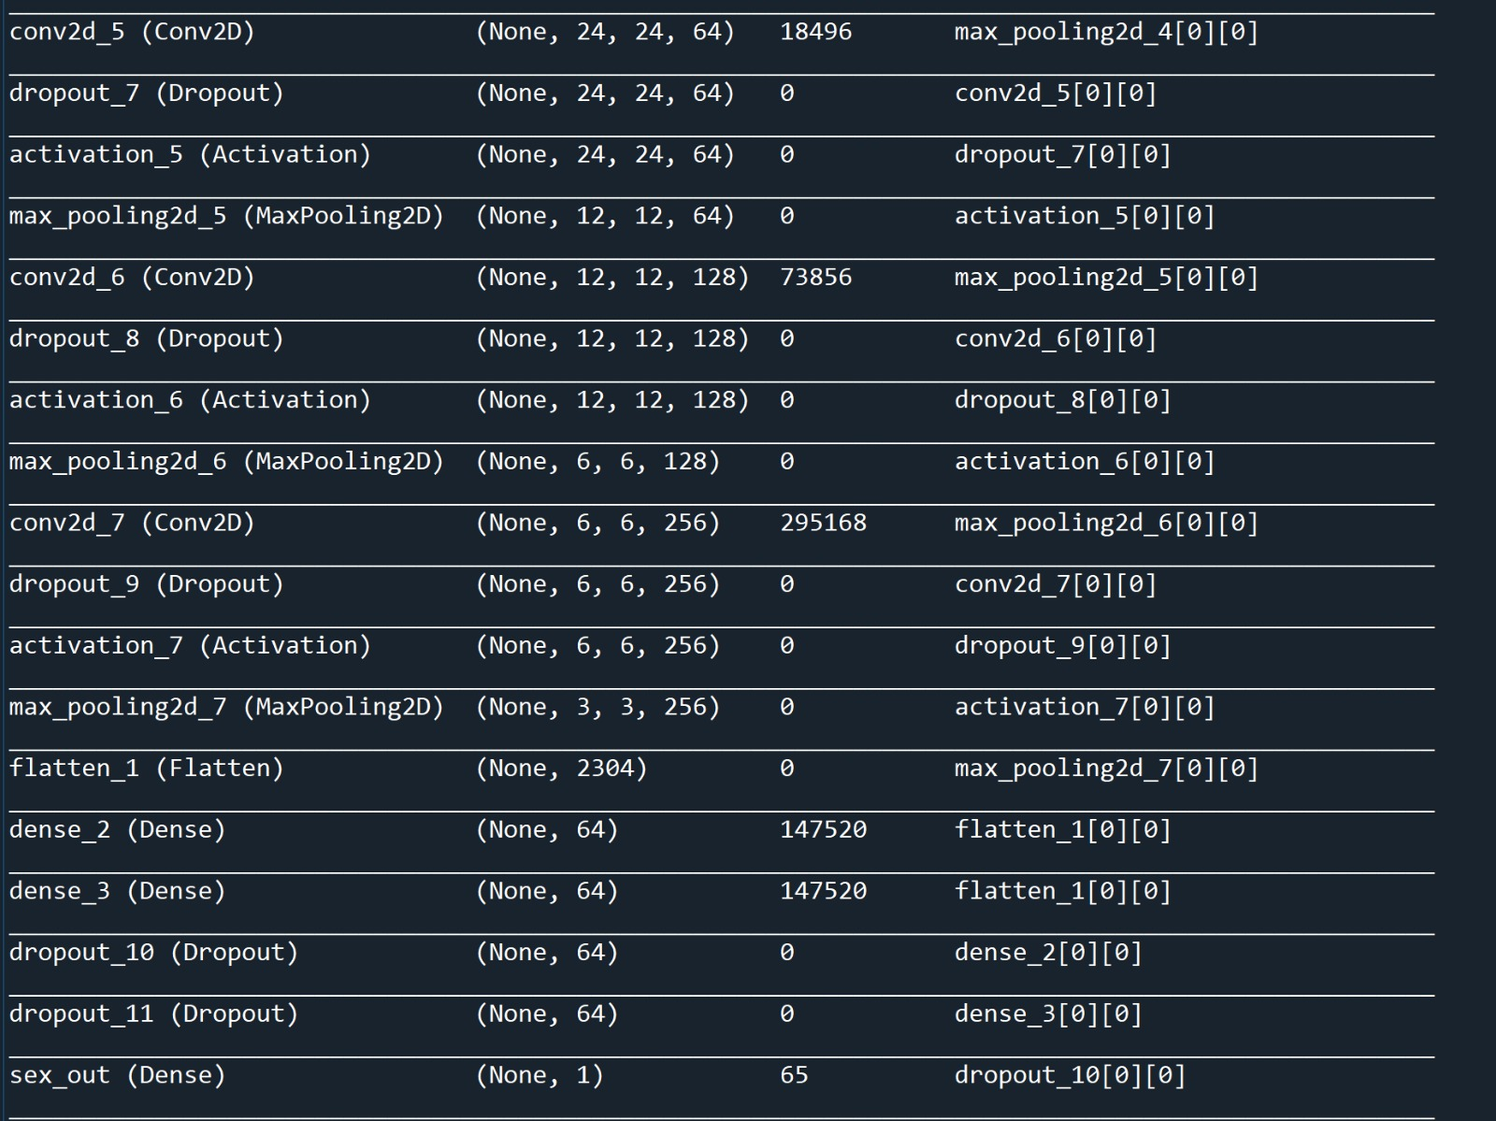
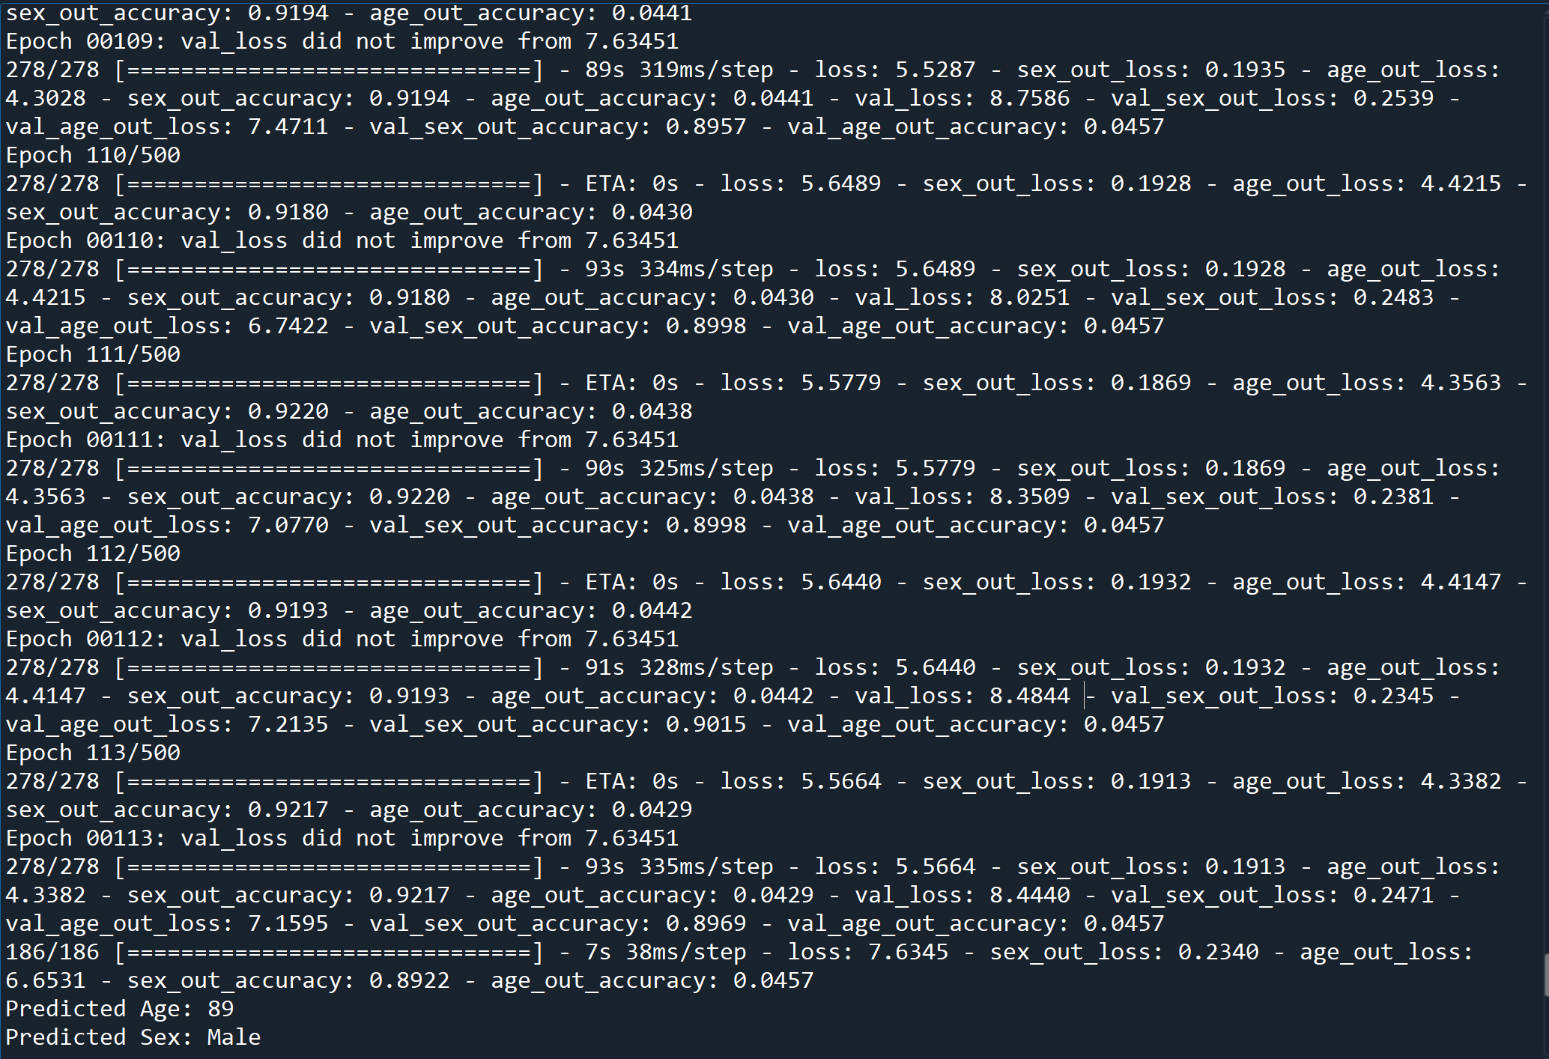
OUTPUT
CNN Table
Process and accuracy of Gender and Age detection

Slide 13
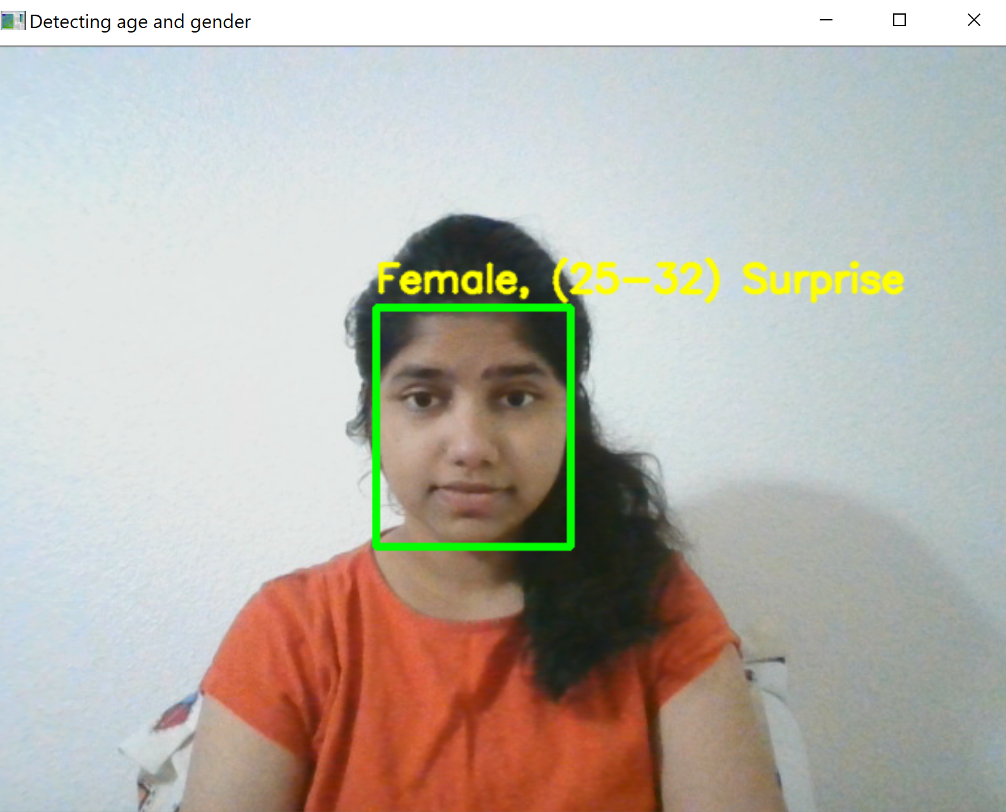
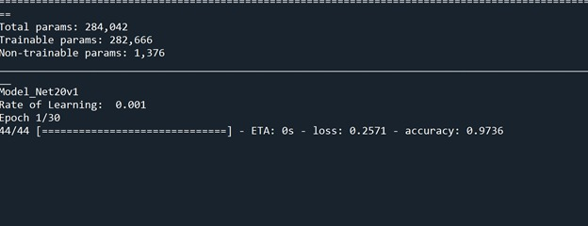
Testing Using Open CV
Process and accuracy of emotion detection

Slide 14
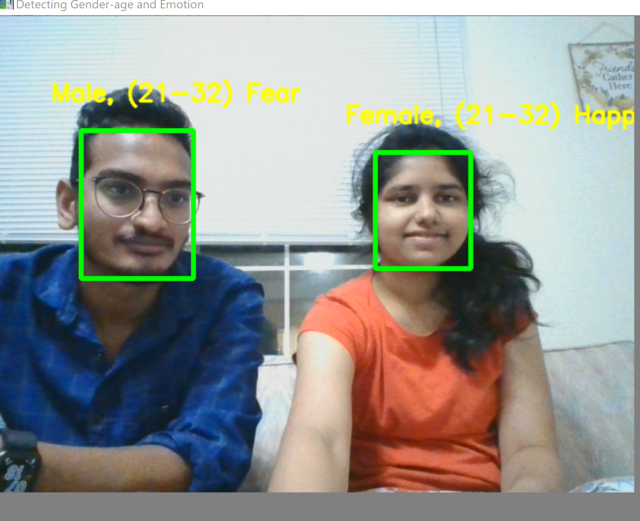
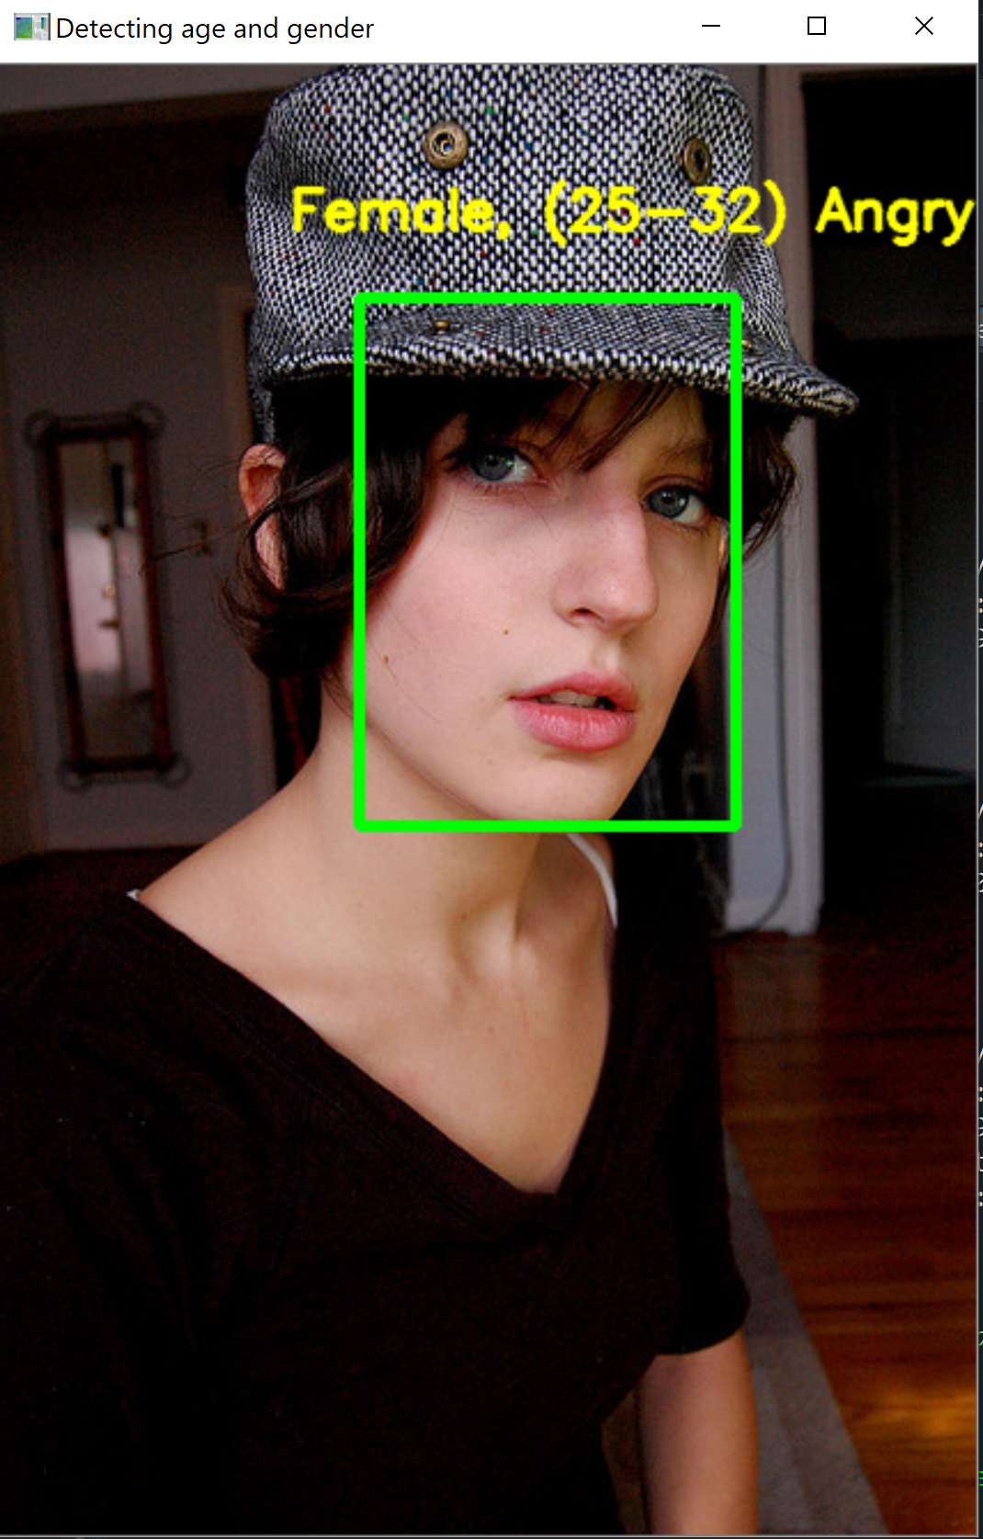
Multi faces detected
Testing using COCO images

Slide 15
CONCLUSION
We have implemented a CNN to predict both the gender-age and emotion from facial images in this project.
We have detected faces, then classified them into male/female with age ranges and emotions and then the results are displayed on the image.

Slide 16
Any Questions???

Slide 17


